Slide 1
MODULE 4: CRITERIA
Content consistency
Question understanding
Vocabulary and grammar
Accent and pronunciation

Slide 2
MODULE 4: TOPICS
TOPIC
INTERVIEW SCHEDULE
WORK SCHEDULE
COURSE PROGRAM
RESUME
ITINERARY
EVENT/TOUR SCHEDULE

Slide 3
MODULE 4: TOPICS
1. Time
10:00 A.M. | Ten A.M. | 11:45 A.M. | Eleven forty-five A.M.
12:00 P.M. | Twelve P.M. | 2:00-3:00 A.M. | From two to three A.M.
10:15 | A quarter past ten | 11:45 | A quarter to twelve
4:30 | Half past four | 5:30 | Half past five
Giới từ: at + time

Slide 4
MODULE 4: TOPICS
2. Year – Month - Day
1983
2012
Feb.1
Nov.3
May 5
Mar. 2
Oct. 12, 2000
August 31
Wed. Dec. 23
Nineteen eighty-three
Two thousand twelve
February first
November third
May fifth
March second
October twelfth, two thousand
August thirty-first
Wednesday, December twenty-third
Giới từ:
On Tuesday
On May 15
In August
In 2016

Slide 5
MODULE 4: TOPICS
3. Money
$1
$15
$230
$12.50
$10,000
$1,525
$2,010
One dollar
Fifteen dollars
Two hundred and thirty
Twelve point five dollars
Ten thousand dollars
One thousand five hundred and twenty five
Two thousand and ten

Slide 6
MODULE 4: TOPICS
4. Number
50%
Room 414
Flight No. 785
860 Jason St.
540 – 0392
1-800-398-9932
Fifty percent
Room four one four
Flight number seven eight five
Eight six O Jason Street/ Eight sixty Jason Street
Five four O – O three nine two
One – eight O O – three nine eight – nine nine three two

Slide 7
MODULE 4: PREP
In +
In room 305 | In the conference room
In Seattle | In Italy
At +
At 125 Jasper St. | At Carleton Co.
At Mason University | At the Lincoln Art Center
At JFK Airport | At the Regal Theater
On Main Street | On the 5th floor

Slide 8
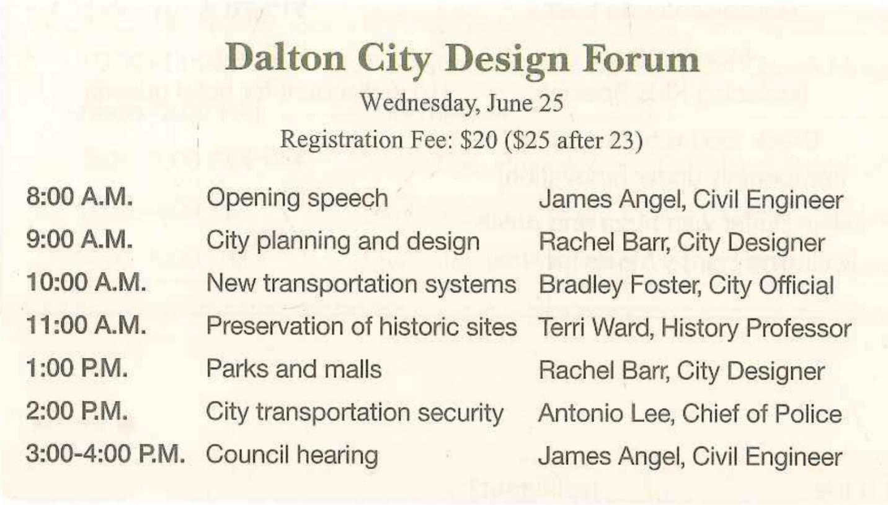
TOPIC 1: EVENT SCHEDULE

Slide 9
TOPIC 1 : EVENT SCHEDULE
Be held | It will be held on Tuesday, April 22nd
Take place | It will take place at Crown Hotel
Give/ given by | Sam Anderson will give a speech. There will be a speech given by Sam Anderson.
Lead/ led by | Ray Ford will lead a question and answer session. There will be a question and answer session led by Ray Ford.
Start/begin Finish/ end | It will start at 9 a.m, and it will finish at 4 p.m.

Slide 10
TOPIC 1: WORK SCHEDULE
There will be | There will be a client meeting.
Participate in/attend | You will participate in/attend a sales meeting.
Talk about | You will talk about the new management.
Have | You will have a meeting with Tyler Watkins.
Schedule conflict | There will be a schedule conflict
Mandatory | It will be mandatory to participate
Has been postponed until | It has been postponed until July.
Has been rescheduled for | It has been rescheduled for Saturday.

Slide 11
TOPIC 1 : EVENT SCHEDULE
Q8: What is my first activity in the morning, and what time does it start?
Your first activity in the morning is a conference call with managers, and it starts at 9:30 A.M
Q9: As far as I remember, I’m supposed to give a presentation to board members in the afternoon. Am I right?
Actually, no. You’re supposed to give a presentation to board members from 11 to 11:30 in the morning.
Q10: I know I will spend some time with new employees tomorrow. Can you give me all the details of any activities with new employees?
Yes, First, you will have lunch with new employees from noon to 1 P.M. Also, you will attend their presentations from 2 to 3:30 P.M.

Slide 12
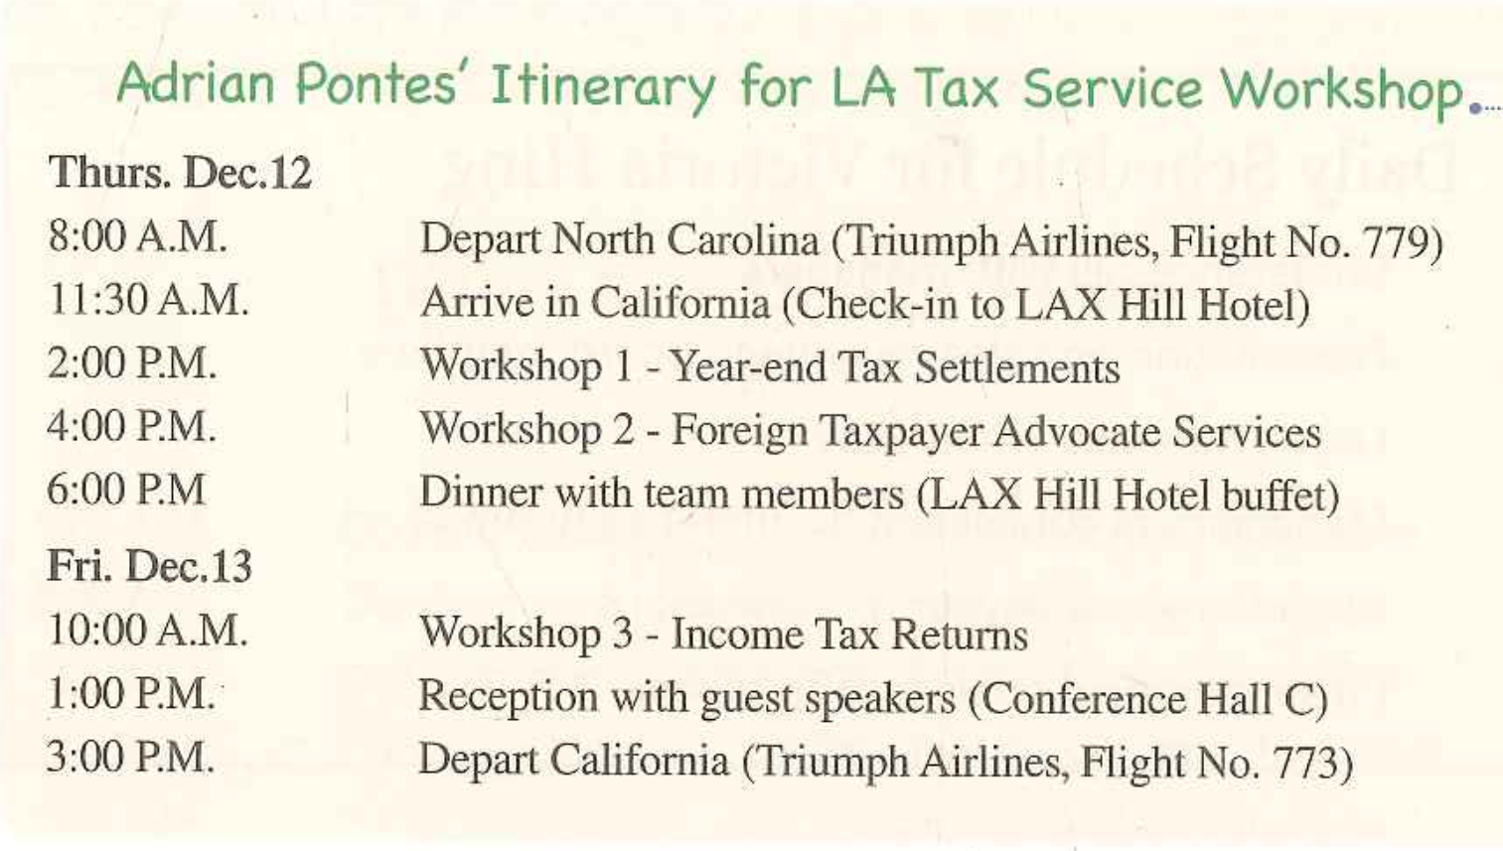
TOPIC 2 : ITINERARY

Slide 13
TOPIC 2 : ITINERARY
Take | You will take Silver Airline #1093
Depart from | You will depart from Los Angeles
Arrive at | You will arrive at JFK Airport. You will arrive in New York at 1:45 p.m
Stay | You will stay at Royal Hotel for 3 days.
Pick A up Drop A off | Tim will pick you up from the hotel and drop you off at the airport

Slide 14
TOPIC 2: ITINERARY
Q8: Which airline will I fly with when leaving for Boston, and what time will I arrive?
Ans: You will fly with United Airlines and arrive in Boston at 12:50 P.M.
Q9: I want to do some sightseeing in Boston on April 24th before I leave. Would it be possible?
Ans: I’m afraid not. You are supposed to depart Boston at 9:15 A.M, so you won’t have time for sightseeing.
Q10: Can you give me all the details about the seminars I will attend in Boston?
Ans: Sure. You will attend two seminars. First, there will be a seminar on performance evaluation from 11 A.M to 12 P.M on April 22nd . Second, you will attend another seminar on new technology in the office from 9 to 11 A.M on April 23rd.

Slide 15
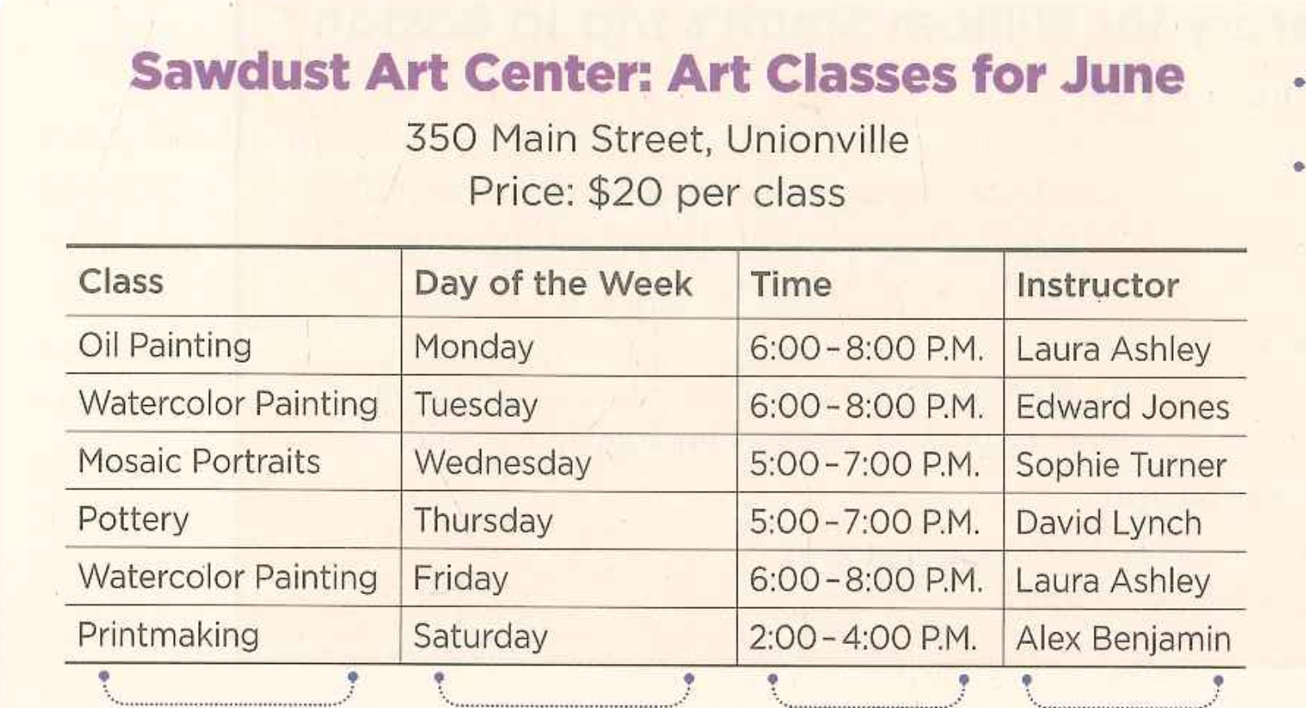
TOPIC 3: CLASS/ COURSE PROGRAM

Slide 16
TOPIC 3: CLASS/ COURSE PROGRAM
Registration deadline | The registration deadline is September 3rd
If | If you register early, it costs $15 per person If you register before (after) 1st May, it costs $15 per person
Learn | You can learn basic Chinese from 7 p.m. to 9 p.m.
Teach | Sam will teach how to speak Chinese for 2 hours
Attend | You can attend a cooking class from 4 p.m. to 6 p.m.
On Mondays/ Every monday | On Mondays, there will be a ballet class Every Monday, there will be a ballet class

Slide 17
TOPIC 3: TOUR PROGRAM
It is ~ long | The registration deadline is September 3rd
Take | If you register early, it costs $15 per person If you register before (after) 1st May, it costs $15 per person
A/an ~ level course | You can learn basic Chinese from 7 p.m. to 9 p.m.
Provide | Sam will teach how to speak Chinese for 2 hours
Offer | You can attend a cooking class from 4 p.m. to 6 p.m.

Slide 18
TOPIC 3: CLASS/ COURSE PROGRAM
Q8: What is the address of the community center, and when does the summer program start?
Ans: Harris Park Community Center is located at 110 Blue Parkway, and the summer program starts on August 1st.
Q9: I heard the price to take a class is 50 dollars. Is that right?
Ans: I’m afraid not. It is 70 dollars per class.
Q10: I work until 6 P.M on weekdays. Can you tell me all the details about the classes that begin after 6 P.M?
Ans: Sure. There are two classes that begin after 6 P.M. One is Comic book Illustration, which is held from 6:30 to 8:30 P.M. every Tuesday. The textbook will be provided. The other one is Swimming, and it is held from 7 to 9 P.M. on Fridays.

Slide 19
PRACTICE 1: THE AD ADCADEMY
Q8: Could you tell me how much it costs to attend?
Ans: Sure. The price to attend is 50 dollar per person, and there are also group rate available.
Q9: For a big seminar like this, I guess you have ten or twelve workshops to choose from, right?
Ans: Actually, there are only three workshop to choose from: Retail Goods, Wholes product and Service. You can choose one to attend from 1 to 4 P.M
Q10: Could you please tell me what topics are going to be discussed in the morning?
Ans: Certainly. At 9 A.M. there’re a session on Defining Your Business Image, followed by Defining the Size of Your Market. Finally, at 10:45 A.M, theirs is a session about Types of Advertising, which ends at noon.

Slide 20
PRACTICE 2: ITINERARY FOR MR.BRIGG
Q8: When is Dr. Briggs scheduled to arrive in Seattle?
Ans: He will arrive in Seattle at 11:20 P.M on May 29th.
Q9: I heard we need to arrange for a car to take him to Portland from Seattle. Is that right?
Ans: Actually, no. He will take the Q-trak train from Seattle King Station to Portland Union Station.
Q10: I know he will stay at Seashore Inn in Seattle, but I forgot where he will stay in Portland. Can you give me all the details about his stay in Portland?
Ans: Sure. He will stay at the Portland Palace Hotel from May 30th to June 1st . He can check in after 2 P.M and should check out by 12 P.M. There is a 10-dollar charge for late check-out.

Slide 21
PRACTICE 3: POWER GYM
Q8: How much does it cost to take a class?
Ans: It is 20 dollars per class.
Q9: I heard that there are some classes on Saturdays. Is that right?
Ans: I think you have wrong information, All of our classes are held on weekdays.
Q10: I’m thinking of taking a class during my lunch break. Can you give me all the information about the classes held between 12 and 1:30 P.M.?
Ans: Certainly. There are 2 classes held between 12 to 1:30 P.M. First, Aerobics will be constructed by Barbara Berners on Monday from 12 to 1 P.M. Second, yoga classes will be taught by Chris Stark on Wednesday from 12 to 1 P.M.

Slide 22
PRACTICE 4: COMPANY TOUR
Can you tell me what time the tour starts and where we’ll meet first?
Ans: Yes, the tour will start at 8:45 A.M, and we’ll meet in the front lobby of the building.
My schedule says that the video will be shown at eleven o’clock. Is that still correct?
Ans: Actually, that has been changed. The video is going to start at 9”45 A.M. It is about the company’s history and future goals.
I know that a visit to the facilities department is always included in these tours. What other departments will we be visiting?
Ans: First, we will visit the Security Department to make employee ID badges at 9 and learn about entering and leaving the facility at 9:15. After that, we will visit the Information Technology Department at 10:30 to learn about how to use the company computers, printers and fax machines. Finally, we will go to the Health and Safety Department at 11:30 for tour of the nursing station.

Slide 23
PRACTICE 5: MARLON VALLEY
When was the event and where was it held?
Ans: The event was held on Saturday, May 17th, from 5 to 9:30 in the evening. It was at the Clefton Riverside Hotel.
Could you tell me about the special concert, given by children from the Children’s Ward, at 7:30?
Ans: Actually, three was no concert. Instead, there was an auction of artwork by the children from the Children’s Ward at that time.
What did Marian Cramer talk about?
Ans: The vice president, Marian Cramer, reported on the hospital’s improvement plants. The report included information about building expansion, new equipment, and additional staff.

Slide 24
PRACTICE 6: EMMONS COMPANY
What is my first activity in the morning, and what time will it start?
Ans: Your first activity is to attend the breakfast for new employees o the conference room at 9 A.M.
I believe I scheduled a lunch tomorrow with Mr. Kim. That’s still scheduled for tomorrow, right?
Ans: Let me see. It looks like there was a lunch scheduled with Mr. Kim, but lunch was canceled. It is rescheduled for November 21st.
I know I have a few important things on my schedule related to the budget. Could you give me all the details you have for any items on my schedule specifically about the budget?
Ans: Sure, you need to finish the budget report between 9:30 to 10 a.m, and e-mail it to the director by 10 A.M. Also, there will be a budget discussion with the director in the meeting room B at 3 P.M.

Slide 25
PRACTICE 7: HATTLEY CENTER
How much does it cost to register for the conference?
Ans: Advance registration is 80 dollars and same-day registration is 90 dollars.
On May 16, I won’t be able to arrive until 9 A.M/. Will that be a problem?
Ans: It won’t be a problem at all. The conference will start at 9:30 A.M, so you won’t miss anything.
I heard Alan Forrester speak once, and I really enjoyed his sessions. Could you give me details on any sessions led by Alan Forrester?
Ans: Sure, Alan Forrester will lead 2 sessions at the conference. First, he will give a lecture titled ‘Know Your Audience’ at 10 A.M on May 16th. Second, he will lead a workshop on’ Branding Stratergies’ at 3:30 P.M on May 17th.

Slide 26
PRACTICE 8: OLSON COMMUNITY CENTER
What is the address of the community center, and on what date do classes begin?
Ans: Olson Community Center is located at 831 Pine Street and the classes begin on June 3rd.
I heard that the price to take a class is $125. Is that correct?
Ans: I’m afraid not. it is 150 dollars per class.
I work until 5 P.M Monday through Friday. Could you give me all the details of any classes that begin after 5 P.M?
Ans: Sure. We are offering two classes after 5 P.M. One is ‘Basic Accounting’., which is from 5:30 to 7:30 P.M. on Tuesday. The textbook is included in the price. The other is “Advertising Made Easy” and it is held from 6 to 8 P.M. on Thursday.

Slide 27
PRACTICE 9: TEACHER CONFERENCE
I know that Sofia Bruno is leading a discussion of the district math performance. What’s the date and time of that discussion?
Ans: That discussion starts at 10 A.M and will be on June 20th.
A friend of mine, Yanfang Sun, is getting an award. That’s on the second day of the conference, right?
Ans: Actually, no. It will be on the first day of the conference, at 4 P.M on June 20th.
I teach computer science, and I’m most interested in technology issues. Could you tell me all the details about the sessions that are specifically about technology?
Ans: Let me see… There will be two sessions on technology. First, Hannah Ellis will give a presentation on Technology in the Classroom at 10 A.M on June 21st. Second, Mehmet Ali will lead a workshop on Student-Centers Technology at 1 P.M on June 21st.

